Slide 1

Stacks

Slide 2
Stack
A stack is a container of objects that are inserted and removed according to the last-in-first-out (LIFO) principle.
Objects can be inserted at any time, but only the last (the most-recently inserted) object can be removed.
A stack is a simple but powerful data structure which its basic operations include empty, peek, pop, and push.

Slide 3
Inserting an item is known as “pushing” onto the stack.
“Popping” off the stack is synonymous with removing an item.
Stacks are useful to process information in the reverse of the order that it is encountered.
Java.util.Stack is implemented as an extension of the Vector class.

Slide 4
Real world examples
  A stack of plates in a cupboard
  A stack of hay bales in a barn
  When accessing elevator

Slide 5
Three ways to implement a stack:
Using an object of a class that implements the List interface as a container.
Using an array as a container.
Using a linked list as a container
myArray
7
6
5
4
3
2
1
0
push
pop
myTop
-1

Slide 6
A stack can be represented by a singly-linked list; it doesn’t matter whether the references point from the top toward the bottom or vice versa.
A stack can be represented by an array, but the new item should be placed in the next available place in the array rather than at the end of the array.

Slide 7
stack data structure
Stacks often are drawn vertically:
push
pop
← last item in, first item out
← first item in, last item out

Slide 8
Attributes of Stack
clear() – Clear the stack
isEmpty() – Check to see if the stack is empty
push(el) – Put the element el on top of the stack.
pop() – Take the topmost element from stack.
topEl() – Return the topmost element in the stack without removing it.

Slide 9
empty stack
push an element
top
top
A
push another
pop
top
B
top
A
A

Slide 10
Array Based Implementation
To push an item into a stack , we need an auxiliary integer variable known as stack pointer, which stores the array index currently being used as the top of the stack.
A stack can be implemented with an array and an integer.
The integer TOS (top of stack) provides the array index of the top element of the stack, when TOS is –1 , the stack is empty.

Slide 11
Stacks specifies two data fields:
The array (which is expanded as needed stores the items in the stack)
TopOfStack (TOS) ( gives the index of the current top of the stack, if stack is empty, this index is –1.)

Slide 12
Java implementation
import java.io.*; // for I/O
class StackX
{
private int maxSize; // size of stack array
private double[ ] stackArray;
private int TOS; // top of stack

Slide 13
Java implementation….
public StackX(int s) // constructor
{
maxSize = s; // set array size
stackArray = new double[maxSize]; // create array
TOS = -1; // no items yet
}

Slide 14
Push
Insert a new item into the stack.
But initially we have to check whether the stack is full.

Slide 15
isFull()
Returns true if stack is full , false otherwise.
public Boolean isFull( )
{
Return TOS= = maxSize-1; // (default capacity)
}

Slide 16
Push
If stack is not full then;
Add 1 to the stack pointer.
Store item at stack pointer location.

Slide 17
public void push(object x)
{
if isFull( )
throw new stackexception(“ stack is full”)
stackArray[++TOS]=x;
}

Slide 18
Pop
Remove an existing item from the stack.
But initially we have to check whether the stack is empty.

Slide 19
isEmpty()
Returns true if stack is empty, false otherwise
    public Boolean isEmpty( )
    {
    return TOS= = -1;
    }

Slide 20
Pop
If stack is not empty then;
Read item at stack pointer location.
Subtract 1 from the stack pointer.

Slide 21
Remove the most recently inserted item from the stack.
Exception underflow if the stack is empty.
public void pop( ) throws underflow
{
If (isempty( ))
throw new underflow (“stackpop”);
TOS - - ;
}

Slide 22
top()
Return the most recently inserted item from the stack.
Exception underflow if the stack is empty.
public object top( ) throws underflow
{
if (isEmpty( ))
throw new underflow( “stacktop”)
Return stackArray[TOS];
}

Slide 23
topandpop()
Return and remove the most recently inserted item from the stack.
Exception underflow if the stack is empty.
public object topandpop( ) throws underflow
{
if isEmpty( ) )
throw new underflow (“stack topandpop”);
Return stackArray[TOS - - ];
}

Slide 24
class StackApp {
public static void main(String[] args)
{
StackX theStack = new StackX(10);
theStack.push(20);
theStack.push(40);
theStack.push(60);
theStack.push(80);
while( !theStack.isEmpty() )
{
stack double value = theStack.pop();
System.out.print(value);
System.out.print(" ");
}
System.out.println("");
}
}

Slide 25
Applications of Stacks
Direct applications
  Page-visited history in a Web browser
  Undo sequence in a text editor
  Saving local variables when one function calls another, and this one calls another, and so on.
  Base-ten to base-two conversion.
  Convert sting values in a reverse order.
  Balancing symbols for syntax checks
  Prefix-/Postfix- calculators
Indirect applications
  Auxiliary data structure for algorithms
  Component of other data structures

Slide 26
reverse a string
push
t r a m S
pop
S m a r t
1
5
S
4
m
2
3
a
3
2
r
4
1
t
5

Slide 27
Stacks can be applied in programs for evaluating arithmetic expressions.
When analyzing arithmetic expressions, it is important to determine whether an expression is balanced with respect to parentheses
  (a+b*(c/(d-e)))+(d/e)
Problem is further complicated if braces or brackets are used in conjunction with parenthesis
Solution is to use stacks.

Slide 28
Postponement: Evaluating arithmetic expressions.
Prefix: + a b
Infix: a + b (what we use in grammar school)
Postfix: a b +
In high level languages, infix notation cannot be used to evaluate expressions.
We must analyze the expression to determine the order in which we evaluate it.
A common technique is to convert a infix notation into postfix notation, then evaluating it.

Slide 29
Infix to Postfix Conversion
Rules:
  Operands immediately go directly to output
  Operators are pushed into the stack (including parenthesis)
    Check to see if stack top operator is less than current operator
    If the top operator is less than the current, push the current operator onto stack
    If the top operator is greater than the current, pop top operator and push current operator onto stack
    Priority 2: * /
    Priority 1: + -
    Priority 0: (
If we encounter a right parenthesis, pop from stack until we get matching left parenthesis. Do not output parenthesis.

Slide 30
Infix to Postfix Example
A + B * C - D / E
Infix Stack(bot->top) Postfix
a) A + B * C - D / E empty empty
b) + B * C - D / E empty A
c) B * C - D / E + A
d) * C - D / E + A B
e) C - D / E + * A B
f) - D / E + * A B C
g) D / E + - A B C *
h) / E + - A B C * D
i) E + - / A B C * D
j) + - / A B C * D E
k) A B C * D E / - +

Slide 31
A * B - ( C + D ) + E
Infix Stack(bot->top) Postfix
A * B - ( C - D ) + E empty empty
* B - ( C + D ) + E empty A
B - ( C + D ) + E * A
- ( C + D ) + E * A B
- ( C + D ) + E empty A B *
( C + D ) + E - A B *
C + D ) + E - ( A B *
+ D ) + E - ( A B * C
D ) + E - ( + A B * C
) + E - ( + A B * C D
+ E - A B * C D +
+ E empty A B * C D + -
E + A B * C D + -
+ A B * C D + - E
empty A B * C D + - E +

Slide 32
Postfix evaluation
infix expression: (3 + 4) * (5 - 2)
postfix expression: 3 4 + 5 2 - *
operand stack

Slide 33
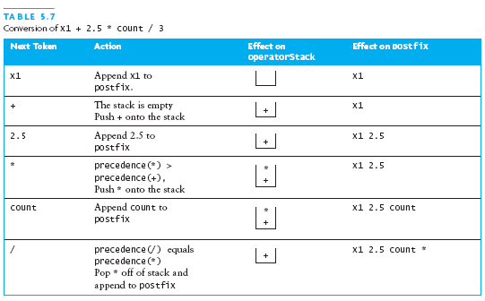
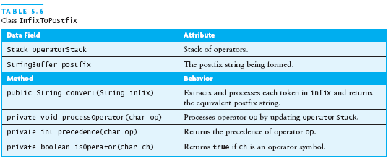
Converting from Infix to Postfix

Slide 34
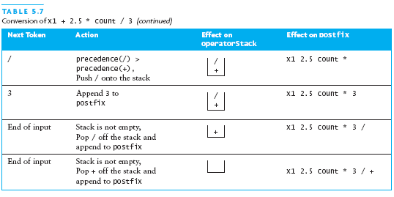

Slide 35
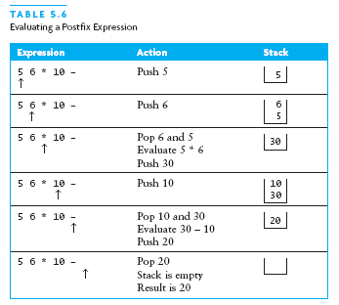
Evaluating Postfix Expressions

